Slide 2
SmartRock™ Plus Sensor

Slide 3
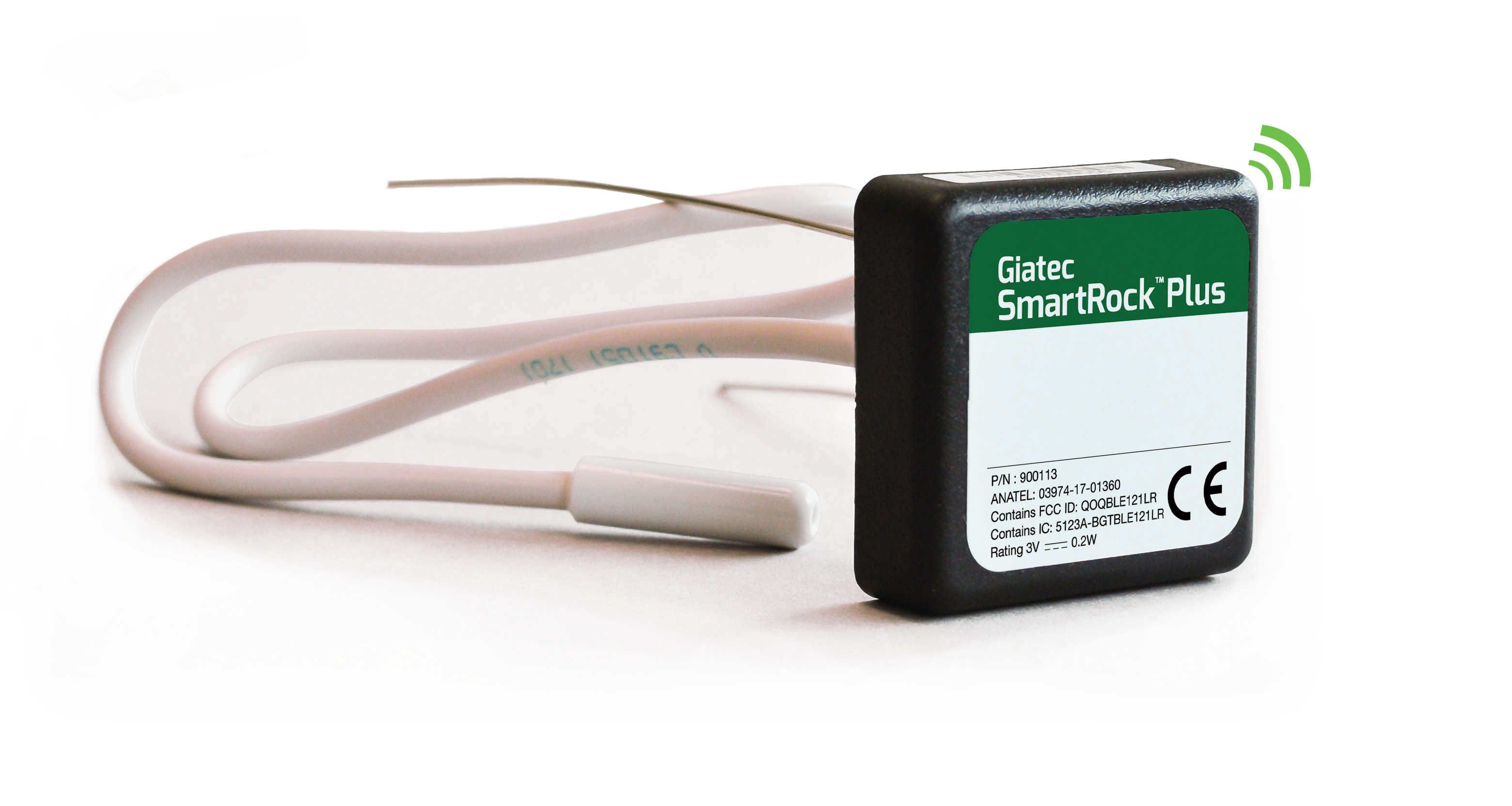
SmartRock™ Plus Sensor
Metal Wires: Activate the sensor and secure the sensor on the rebar.
Temperature Cable: NTC
Black Box: Battery, Bluetooth antenna, and memory.

Slide 4
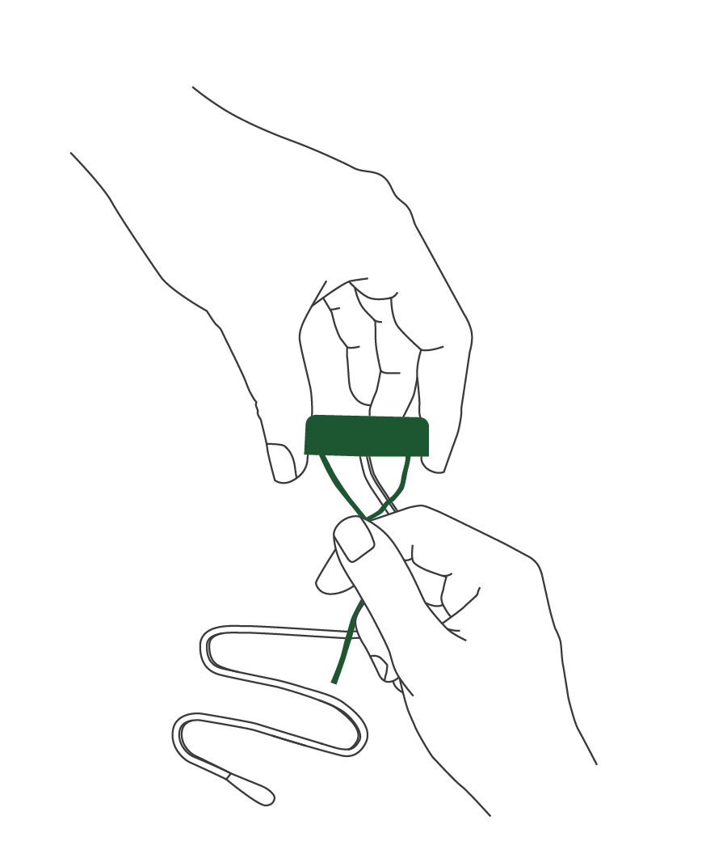
Sensor Features
Logs temperature data every 15 minutes.
Records data for 60 days (5700 data points)
Battery life up to 4 months
16 in or 10 ft temperature cable available
Bluetooth range
  Embedded - up to 25 ft
  Outside – up to 80 ft
Note: If the wires are disconnected, the sensor stops logging data, the battery life is preserved, and the data is saved in the sensor.
Notes:
Imperial

Slide 5
Mobile App

Slide 6

Download the App
The SmartRock™ Plus app can be downloaded for free on the Apple App Store or the Google Play Store.
Notes:
很高兴能让全球25个国家的客户享用最新科技

Slide 7
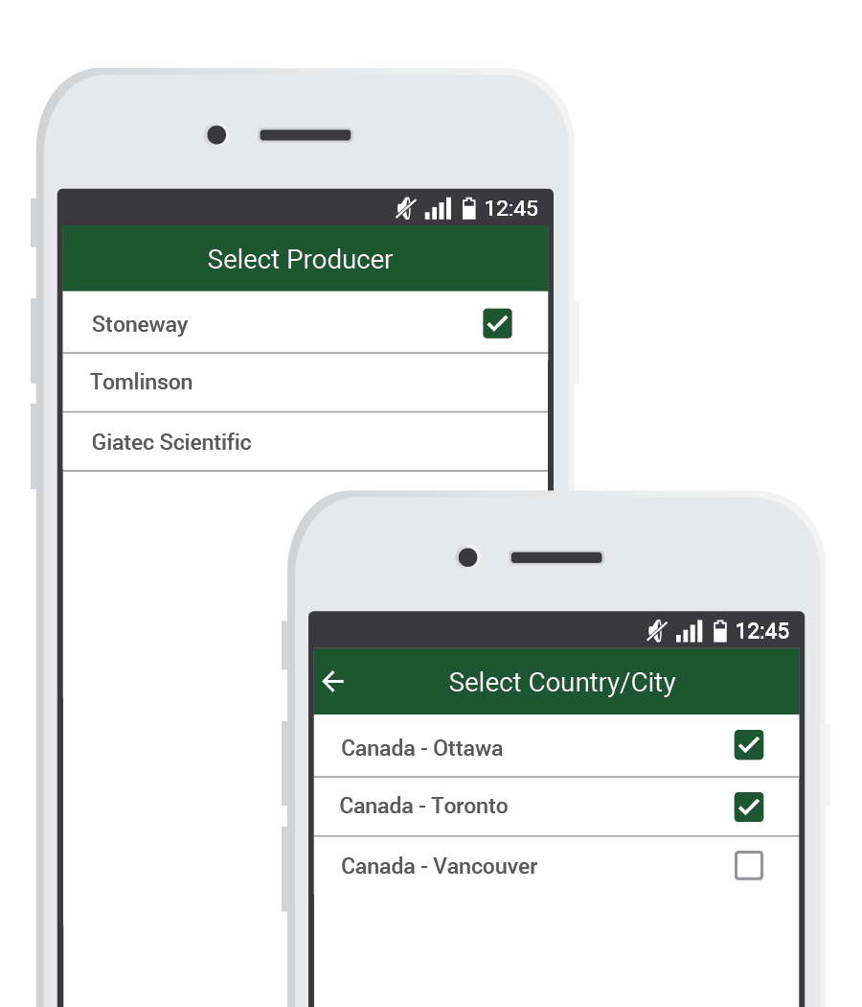
Select your Concrete Producer
After the tutorial the user will need to select the readymix concrete producer and the plants.
The app will automatically customize and brand the app for the readymix producer.

Slide 8
SmartRock™ Plus App Overview
The application has been designed in 3 main portions: Project, Sections, and Sensors
Project: This is the title of your project where all the sensors will be used. A project can be created by selecting “+ New Project” at the bottom of the Active Projects page.
Example: Highrise Building
Section: A section is a section or pour within your project. There can be multiple sections in a project. A section can be created by selecting “+ New Section/Pour”. This page can be found by selecting the project name.
Example: Floor 1
Sensors: Adding a sensor is done by selecting the section that you want to add that sensor to and then selecting “+ New Sensor” at the bottom of the screen.
Example: Sensor 1

Slide 9
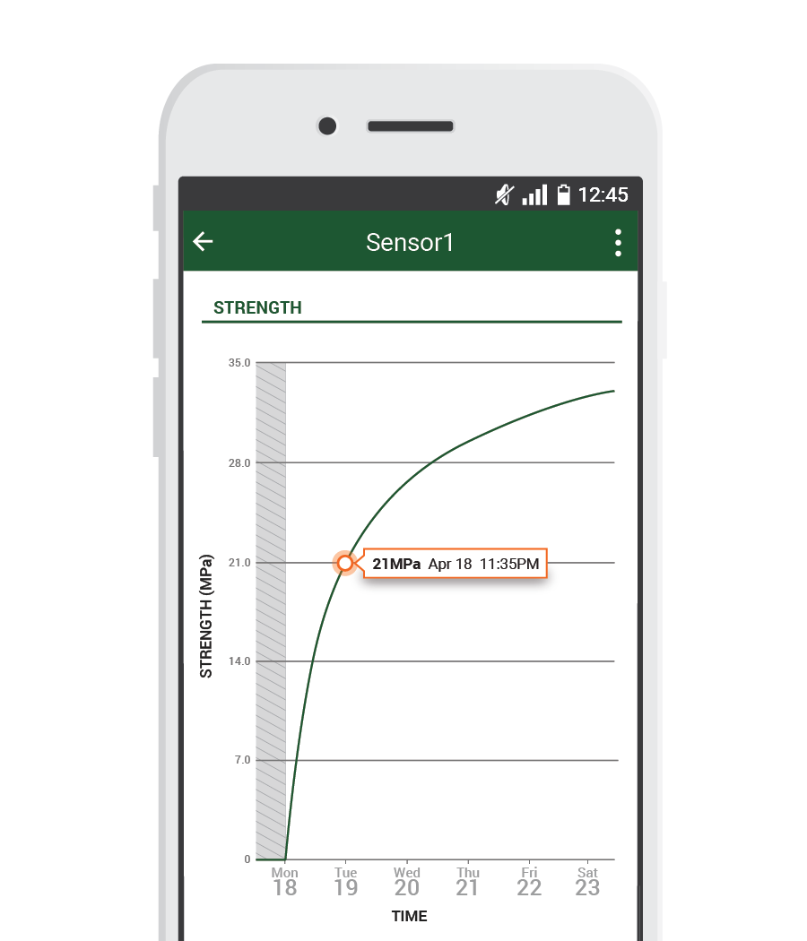
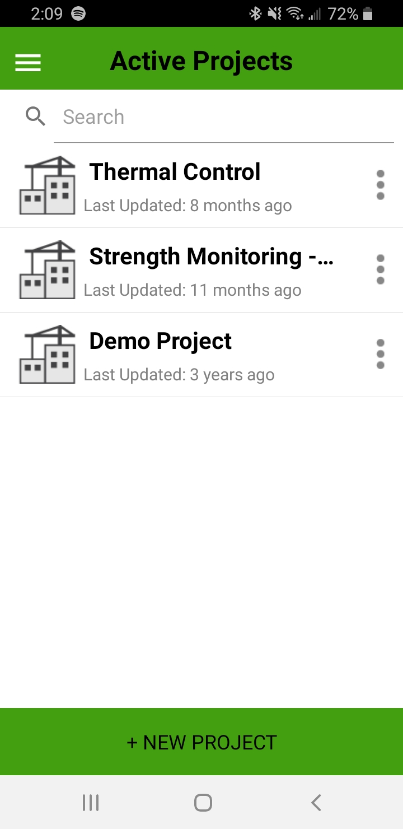
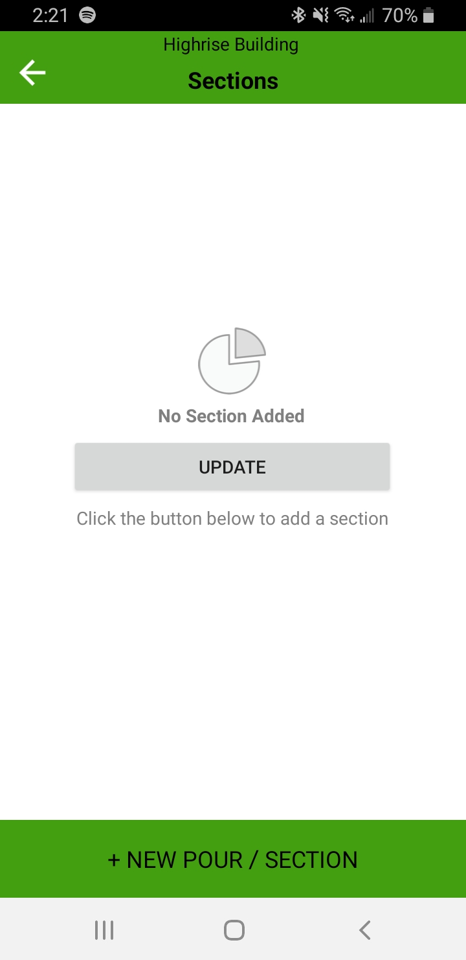
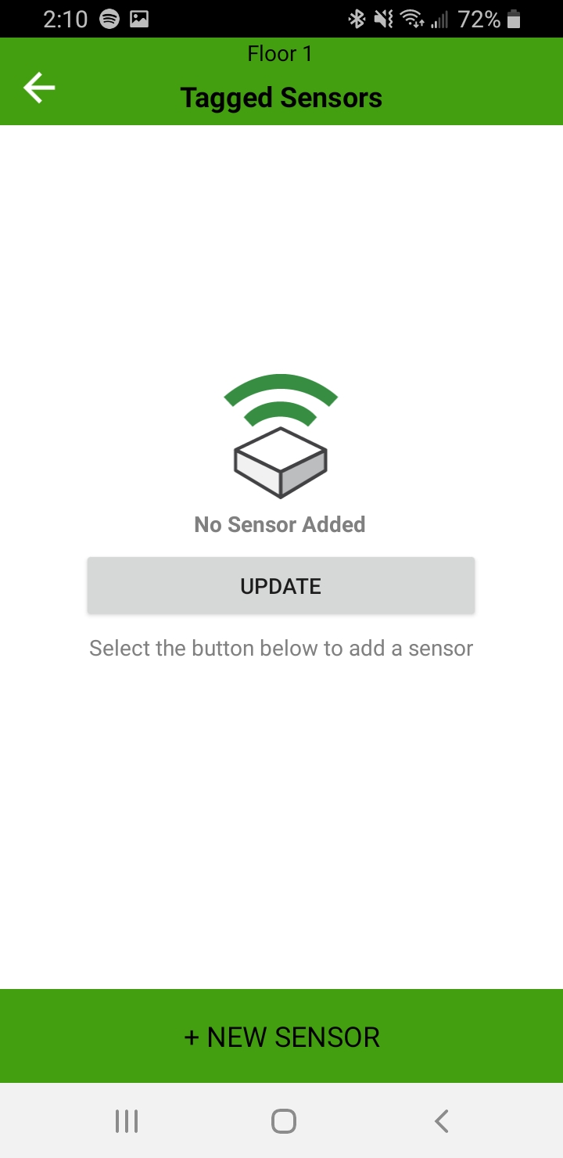
Create a Project, Section and Add Sensors
1. Project
2. Section
3. Sensor
Notes:
Create a project
Create a section
Add sensors to that section
The project should be created on one phone and then shared with the rest of the parties involved.

Slide 10
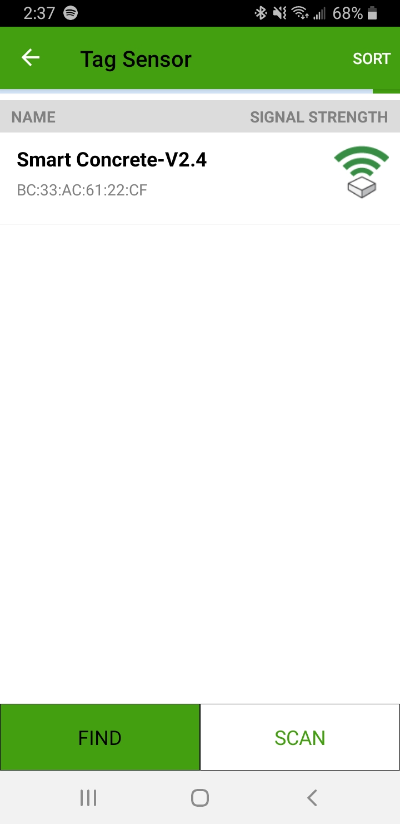
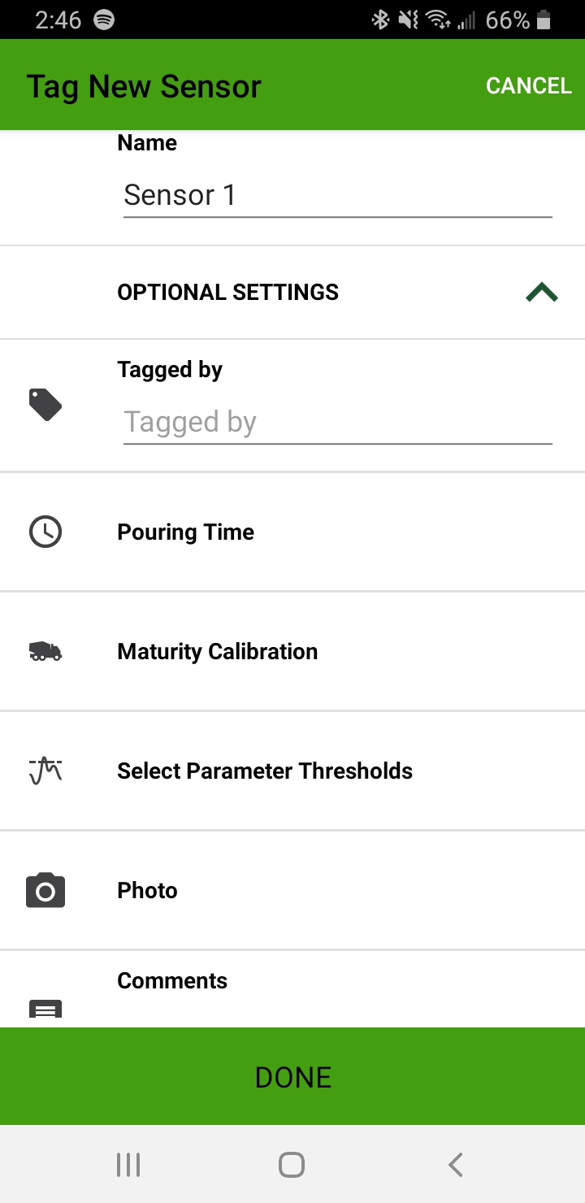
Adding a Sensor
1
2
Twist the wires of one sensor. This activates the sensor.
Turn your phones Bluetooth function on.
Sensor will appear.
Select sensor, give name.
Fill out optional settings (can be edited later).
Select “Done” at the bottom of the screen.
Write sensor name on sensor white label
Sensor Name
Name of sensor installer
Select
Time the concrete touches the sensor
Calibrated mix associated with sensor
Temperature & Strength threshold
Photo of installed sensor
Additional Comments
Notes:
Create a project
Create a section
Add sensors to that section
The project should be created on one phone and then shared with the rest of the parties involved.

Slide 11
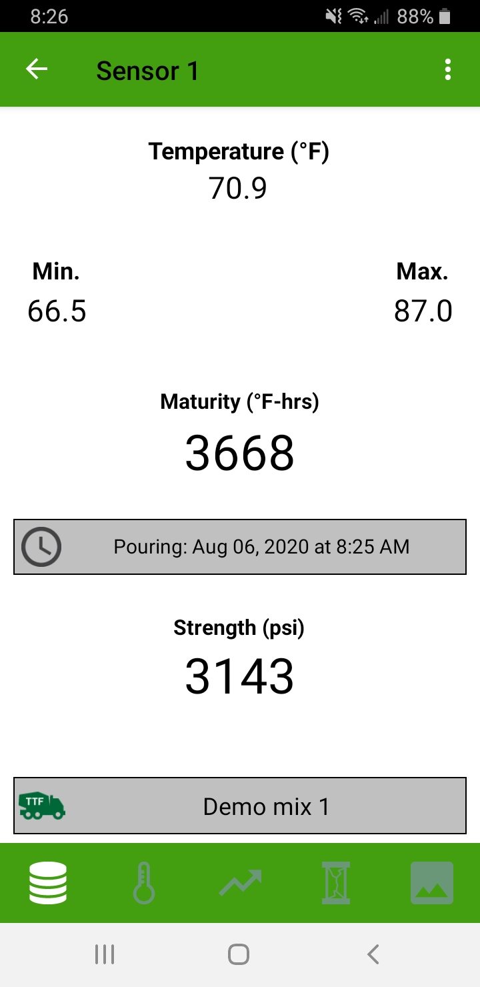
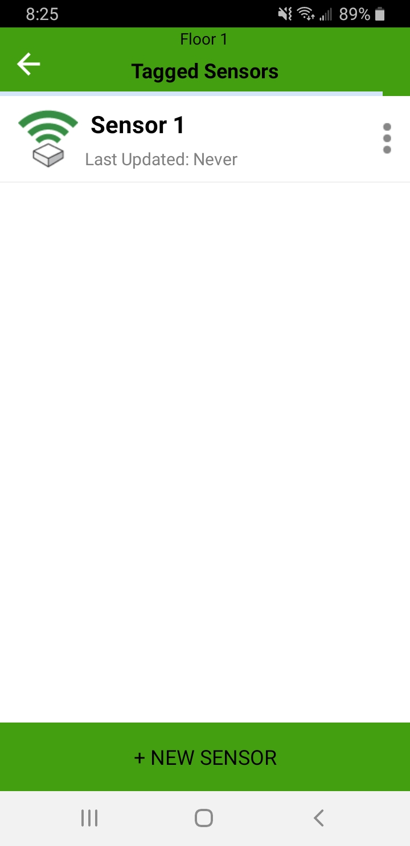
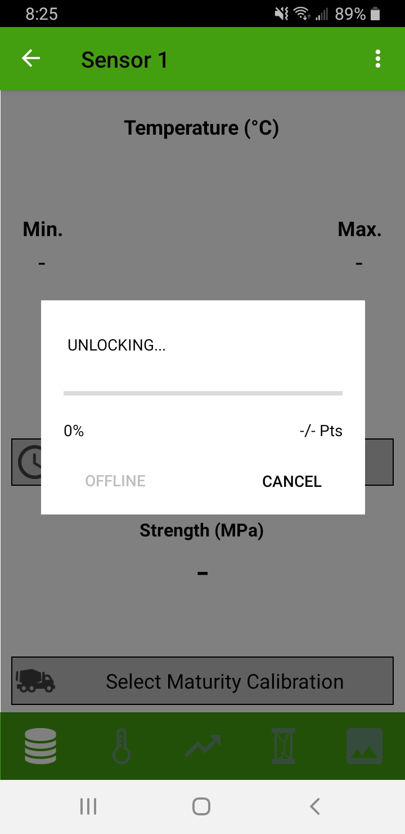
Connecting to the Sensor
1
2
3
Select
Notes:
Imperial

Slide 12
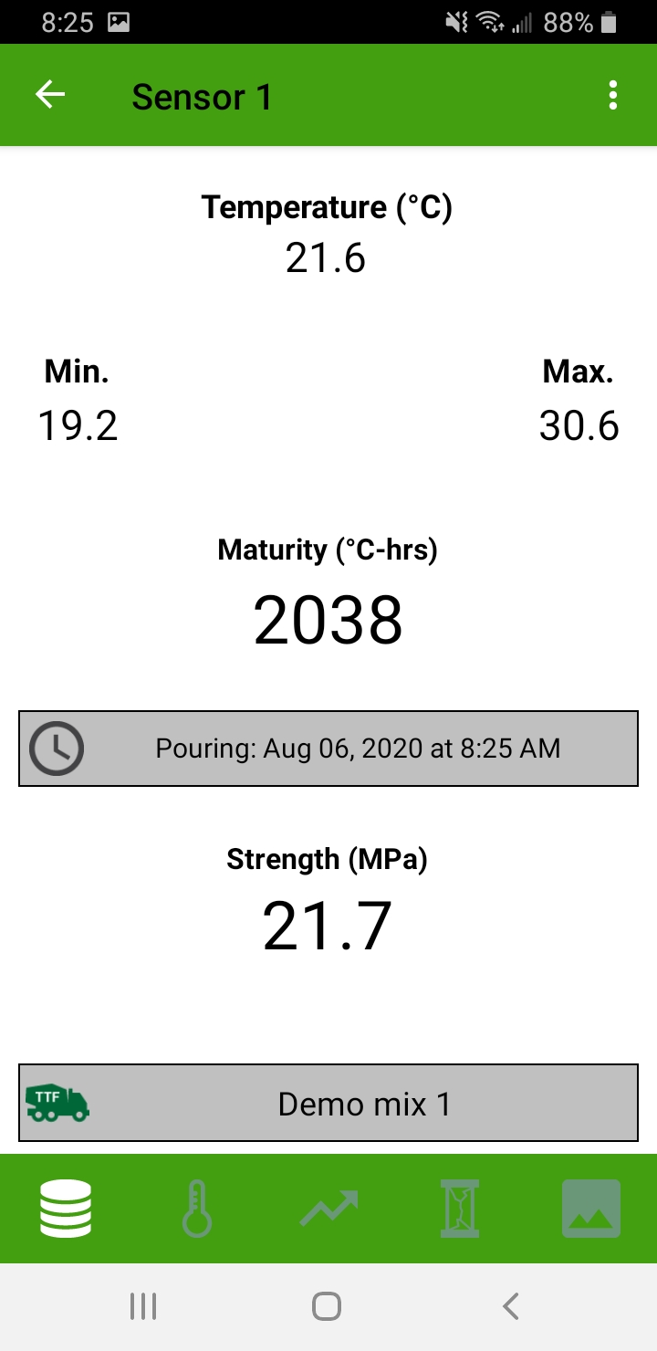
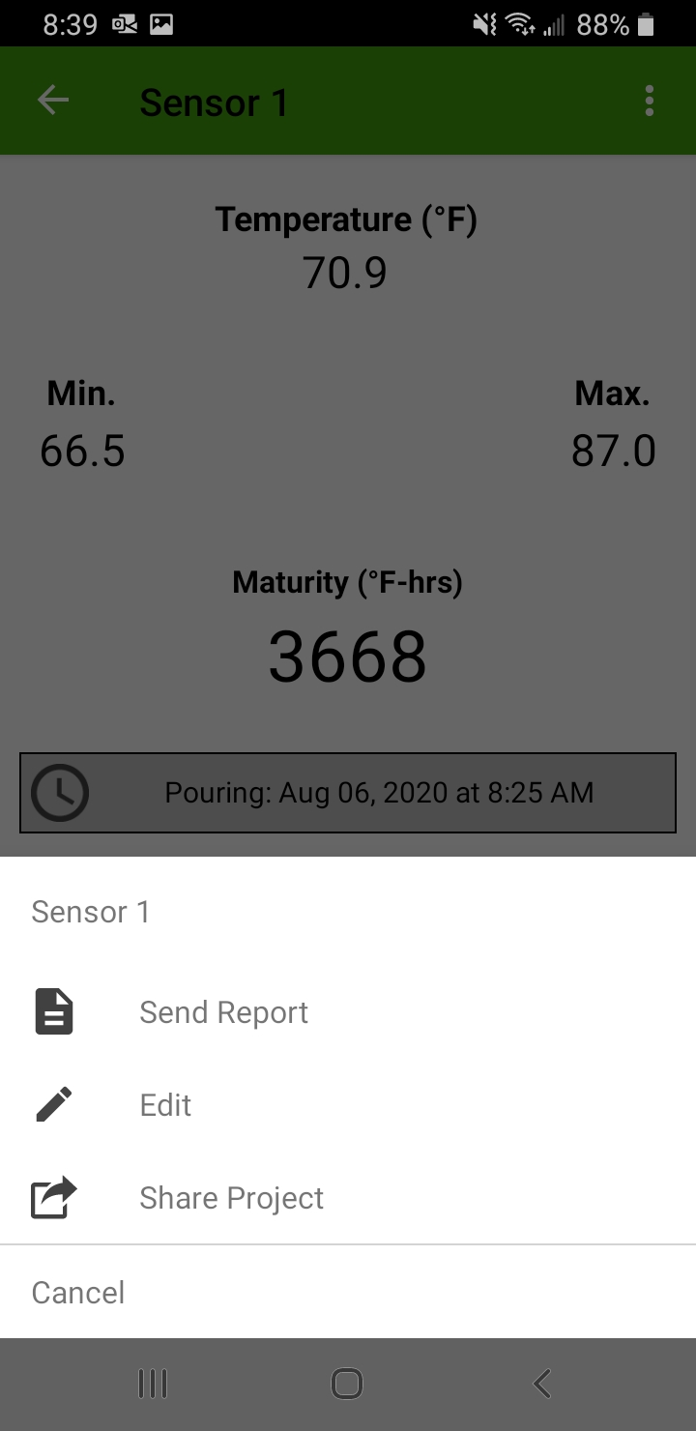
Sensor report / Share project
Select
Send PDF and CSV Sensor Report
Edit sensor’s optional settings
Share project with colleagues
Notes:
Imperial

Slide 13
Installation

Slide 14
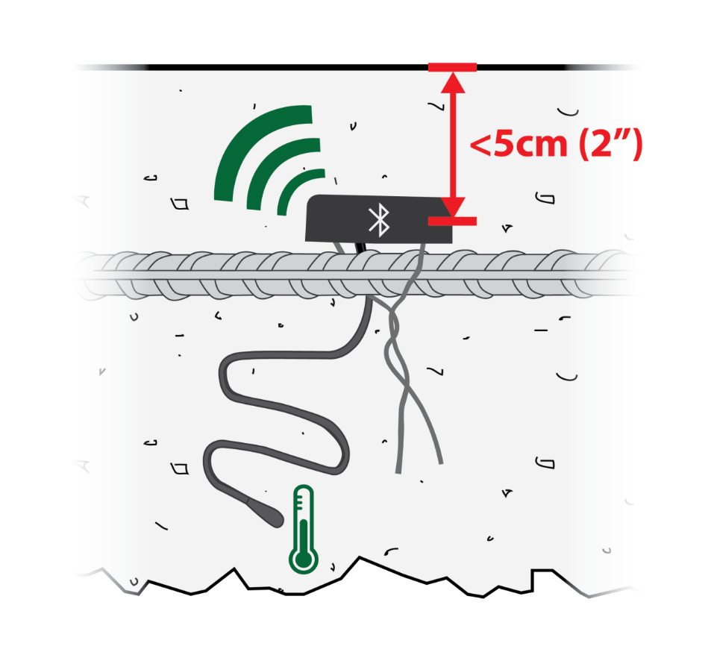
Tagging & Installation
Create Project
Create a project
Turn on Sensor
Twist metal wires together
Locate & name sensor in the app
Name on Sensor
Write the sensor name on the sensors white label
Untwist the metal wires
Untwist the Wires
Create sections within the project
Repeat steps 1-3 for each sensor
It is recommended to tag sensors one at a time in the office
1.
2.
3.
4.
IMPORTANT: The sensor must be placed no more than 2 inches (5cm) below the surface.
Notes:
1. The important but simple installation steps

Slide 15
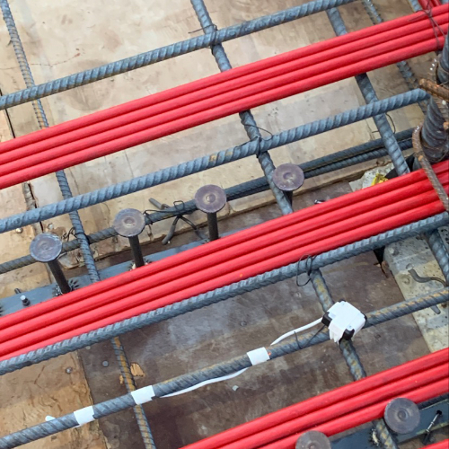
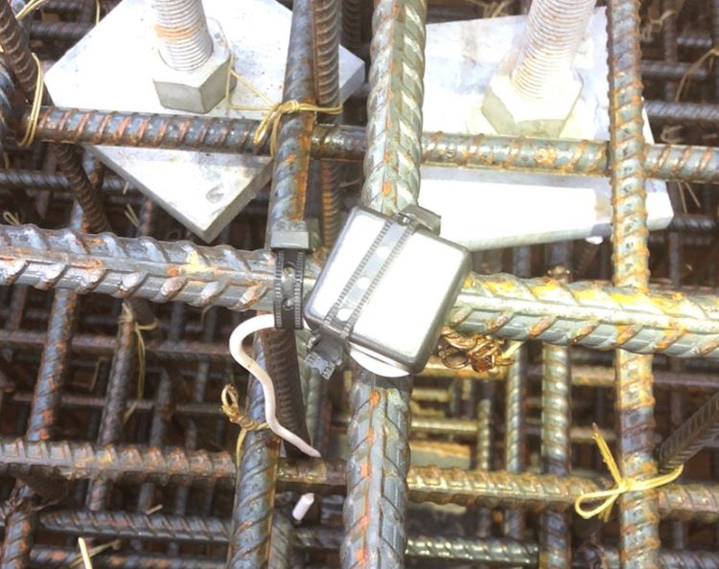
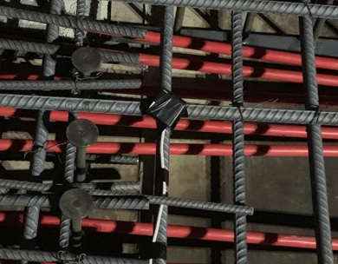
Correct
Installation
Sensor secured with tape on the intersection of the rebar (less than 2 inches or 5cm from the concrete surface)
Temperature cable secured with tape underneath the rebar.
Download data from sensor before concrete pour.
Use blue clips to twist wires together
Notes:
1. An example of a sensor installed correctly

Slide 16
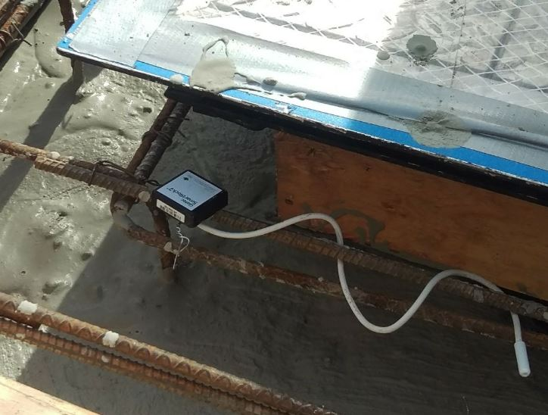
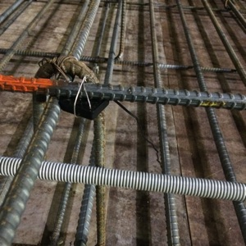
Poor
Installation
Sensor secured without tape on singular rebar.
Loose connection between activation wires.
Temperature cable secured without tape & wrapped around rebar.
Sensor underneath rebar.
Notes:
1. An example of a sensor installed poorly

Slide 17
Installation Tips
The black box must be facing up to provide the best Bluetooth signal possible and within 2 inches or 5 cm on the concrete surface
Twist wires underneath engaging the entire wire tightly. Use the blue clips
The temperature cable must be placed in such a way to prevent workers damaging them, simply run the cable under the rebar
The sensors must be well secured on intersection of the rebar, use tape or plastic zip ties
Recommended installation : 1 sensor / 150 y³ (Minimum 2 per pour)
Recommended installation : 1 sensor / 100 m³ (Minimum 2 per pour)
  Place at critical locations
  Lowest heat = lowest strength
  Install a minimum of two sensors

